Slide 1
Unix System Administration
Unit 1:
  Linux OS structure
  Distributions
  Hardware inventory
  Disks and partitions
  Installation steps
  Boot loader

Slide 2
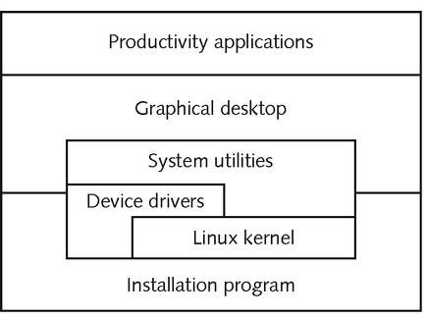
Linux Distribution

Slide 3
Popular Linux Distributions
Redhat
Fedora
Suse
Debian
Ubuntu
Mandriva
Gentoo
Slackware
www.distrowatch.com

Slide 4
Useful Hardware Information for
Installing Linux
Processor | Pentium III 1Ghz
memory | 512MB
hard disk | 40GB IDE
video card | GeForce2 32MB
network card | 3Com Fast Etherlink
… | …

Slide 5
Overview of Linux Installation
Installation is started by booting from
  floppy disk, CD
  other bootable device: network, USB
Installation tasks:
  identify source of the Linux files
  answer miscellaneous questions
  identify target partition(s)
  define what software to install and configure
  configure boot loader

Slide 6
Installation sources
CD-ROM
Hard disk
Floppy disk, USB device
Network installation
  ftp
  http
  nfs

Slide 7
Answer Questions
language
keyboard
time zone
superuser password
network setup
initial firewall configuration
create initial user(s)

Slide 8
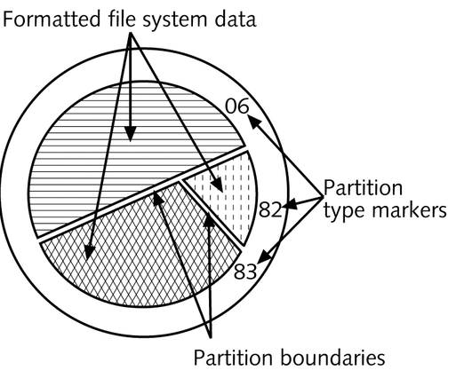
Identify Target Partitions

Slide 9
Preparing Hard Disk Partitions
physical vs. logical
  IDE disks: /dev/hda /dev/hdb
    partitions numbered starting with 1
    example: /dev/hda1
  SCSI disks: /dev/sda
file system vs. swap space
  file system type
  mount point

Slide 10
Some Target Partitions
/
  root file system
optional: /boot
  for boot specific files
swap space
  enables virtual memory
/home
  users’ home directories

Slide 11
Select Installation Type
personal desktop
workstation
server
custom

Slide 12
Select Software Packages
GUI: X11, Gnome, KDE, lxde
editors
internet browsers and utilities
web server and utilities
developers tools
…
optional: everything

Slide 13
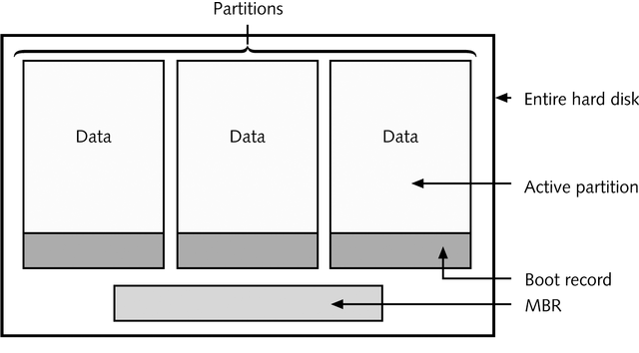
Configuring the Boot Manager
boot manager can be placed:
  master boot record
  boot sector of the active partition

Slide 14
Boot Manager: LILO
Linux loader
configuration
  /etc/lilo.conf
installation
  lilo

Slide 15
Boot Manager: GRUB
Grand Unified Bootloader
  /boot/grub
configuration
  grub.conf
    Naming convention: (hd0,0)
installation
  grub-install

